Slide 1
Cryptography II
Block ciphers and modes of operations

Slide 2
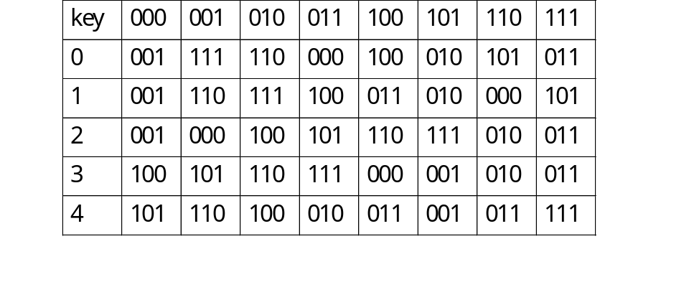
Block ciphers: getting the concept
Stream cipher vs. block cipher: single unit vs. block of units
Plaintext= 010100110111= (010)(100)(110)(111)
  ➔ Ciphertext = 111 011 000 101 theo key=1
  ➔ Ciphertext = 100 011 011 111 theo key=4
There are 5 keys, 2² < 5 < 2³ ➔ need keys in 3 bits to present➔ key size= block size= 3.
Small sizes are dangerous, however: If Eve catches C=001 ➔ can infer P= 000 or 101.

Slide 3
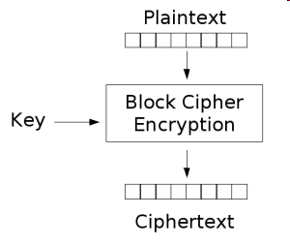
Block cipher: an invertible map
Map n-bit plaintext blocks to n-bit ciphertext blocks (n: block size/length).
For n-bit plaintext and ciphertext blocks and a fixed key, the encryption function is a bijection:
  E : P_{n} x K → C_{n} s.t. for all key k ∈ K, E(x, k) is an invertible mapping written E_{k}(x).
The inverse mapping is the decryption function, y = D_{k}(x) denotes the decryption of plaintext x under k.

Slide 4
General condition in creating secure block ciphers
The block size has to be large enough to prevent against statistical analysis
  However, larger block size means slower processing
The key space (then key length) must be large enough to prevent against exhaustive key search
  However, key length shouldn’t be too big that makes key distribution and management more difficult

Slide 5
General principles in designing secure block ciphers
Confusion: As a function, the dependence of the ciphertext on the plaintext should be complex enough so that enemy can’t find the rules
  The function should be non-linear.
Diffusion: The goal is to spread the information from the plaintext over the entire ciphertext so that changes in plaintext affect many parts in ciphertext
  This makes it difficult for an enemy to break the cipher by using statistical analysis
Confusion is made by usings substitutions while diffusion by transpositions and/or permutations.

Slide 6
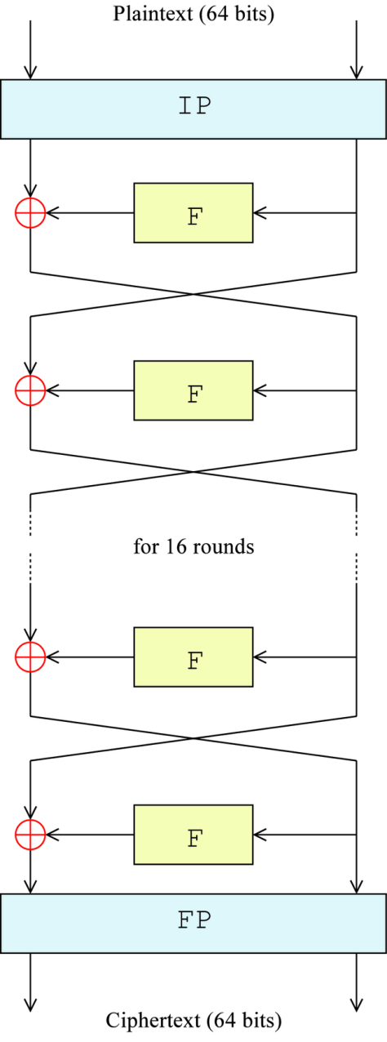
The Feistel structure: processing in rounds
Block ciphers are usually designed with many rounds where basic round accomplishes the core function f for basic confusion and diffusion.
  The input of a round is the output of the previous round and a subkey which is generated by a key-schedule algorithm
The decryption is a reverse process where the sub-keys are handled in the reverse order
The overall Feistel structure of DES

Slide 7
Block Ciphers Features
Block size: in general larger block sizes mean greater security.
Key size: larger key size means greater security (larger key space).
Number of rounds: multiple rounds offer increasing security.
Encryption modes: define how messages larger than the block size are encrypted, very important for the security of the encrypted message.

Slide 8
History of Data Encryption Standard (DES)
1967: Feistel at IBM
  Lucifer: block size 128; key size 128 bit
1972: NBS asks for an encryption standard
1975: IBM developed DES (modification of Lucifer
  block size 64 bits; key size 56 bits
1975: NSA suggests modification
1977: NBS adopts DES as encryption standard in (FIPS 46-1, 46-2).
2001: NIST adopts Rijndael as replacement to DES

Slide 9
DES Features
Features:
  Block size = 64 bits
  Key size = 56 bits
  Number of rounds = 16
  16 intermediary keys, each 48 bits

Slide 10
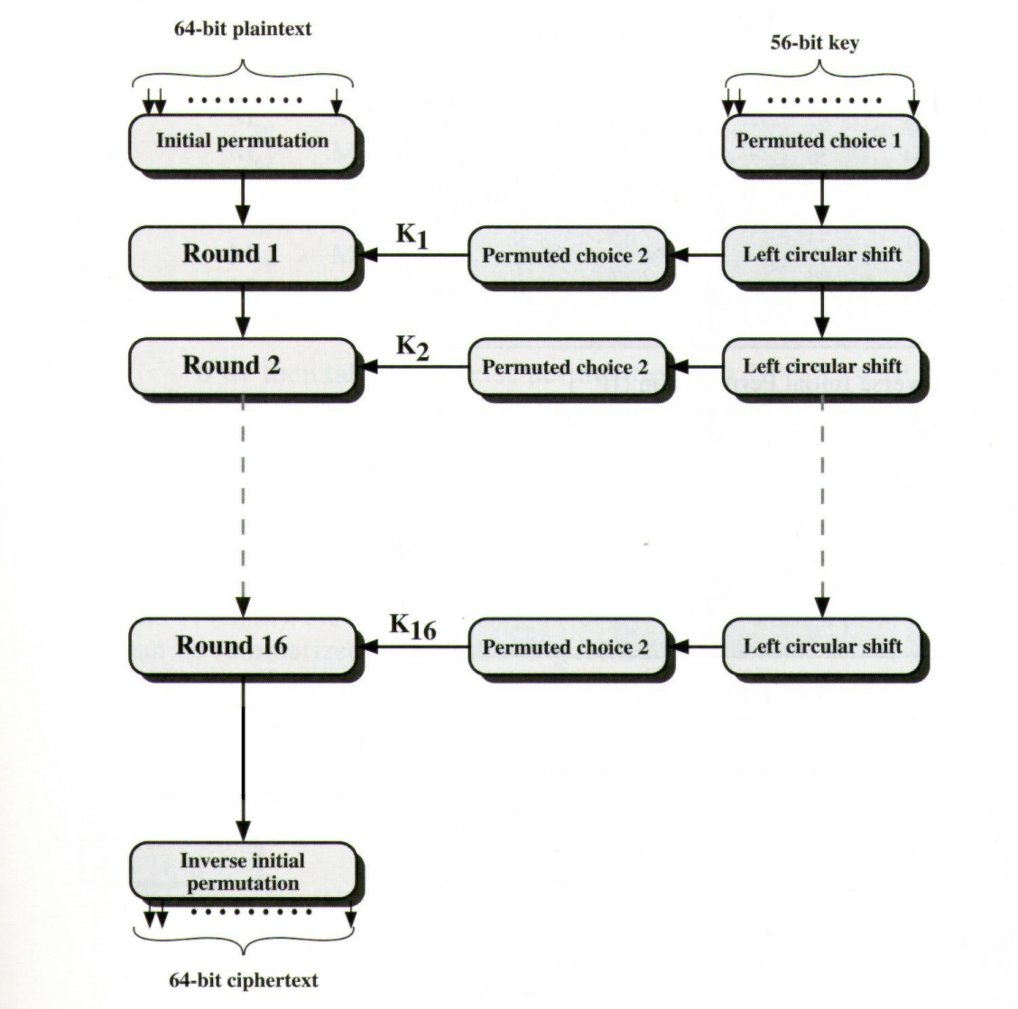
DES Rounds

Slide 11
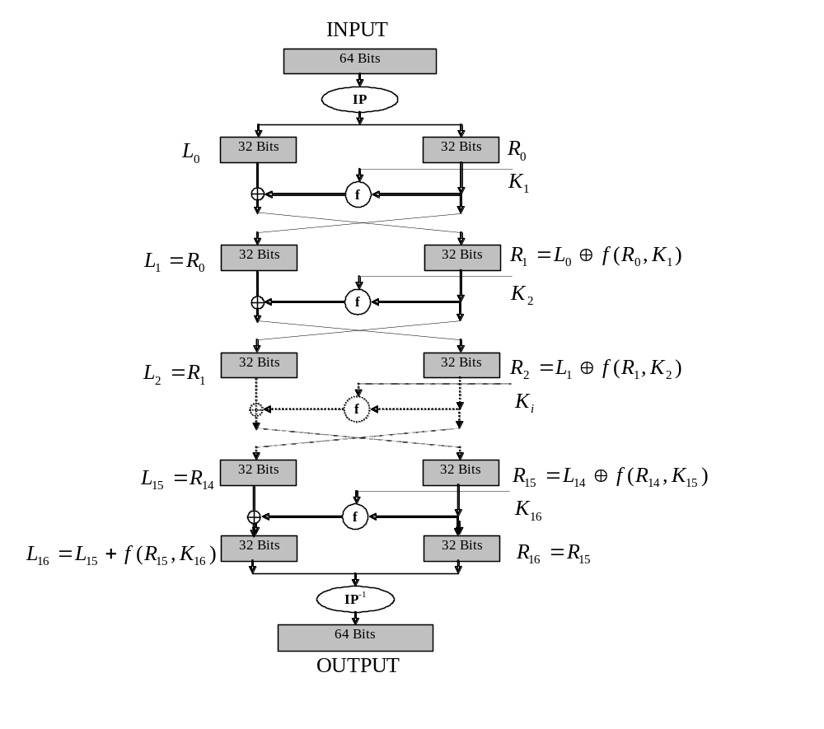
DES encryption: A closer look
Decryption uses the same algorithm as encryption, except that the subkeys K₁, K2, …K16 are applied in reversed order

Slide 12
Cryptanalysis of DES
Brute Force:
Known-Plaintext Attack
Try all 2⁵⁶ possible keys
Requires constant memory
Time-consuming
DES challenges: (RSA)
  msg=“the unknown message is :xxxxxxxx”
  CT=“ C1 | C2 | C3 | C4”
  1997 Internet search: 3 months
  1998 EFF machine (costs $250K): 3 days
  1999 Combined: 22 hours

Slide 13
Rijndael Features
Designed to be efficient in both hardware and
software across a variety of platforms.
Uses a variable block size, 128,192, 256-bits, key size of 128-, 192-, or 256-bits.
128-bit round key used for each round (Can be precomputed and cached for future encryptions).
Note: AES uses a 128-bit block size.
Variable number of rounds (10, 12, 14):
  10 if B = K = 128 bits
  12 if either B or K is 192 and the other is ≤ 192
  14 if either B or K is 256 bits

Slide 14
Rijndael Design
Operations performed on State (4 rows of bytes).
The 128 bit key is expanded as an array of 44 32bits words; 4 distinct words serve as a round key for each round; key schedule relies on the S-box
Algorithms composed of three layers
  Linear diffusion
  Non-linear diffusion
  Key mixing

Slide 15
Decryption
The decryption algorithm is not identical with the encryption algorithm, but uses the same key schedule.
There is also a way of implementing the decryption with an algorithm that is equivalent to the encryption algorithm (each operation replaced with its inverse), however in this case, the key schedule must be changed.

Slide 16
Rijandel Cryptanalysis
Academic break on weaker version of the cipher, 9 rounds
Requires 2²²⁴ work and 2⁸⁵ chosen related-key plaintexts.
Attack not practical.

Slide 17
Modes of Operation (Encryption modes)
Mode of operation (or encryption mode):
  A block cipher algorithm takes on a fixed-length input, i.e. a block, and produce an output, usually a block of the same fixed-length.
  In practice, we want to encrypt files of various length ➔ need to divide a file into block of that given fixed length ➔ then call the encryption algorithms several times
  Operation mode: the manner and structure in which we feed the encryption algorithm (several times) with blocks of the plaintext file and concatenate the resulted blocks to produce the ciphertext file.
The popular modes:
  ECB, CBC, OFB, CFB, CTR
We now overview the properties of certain modes (privacy, integrity) and potential attacks against them.

Slide 18
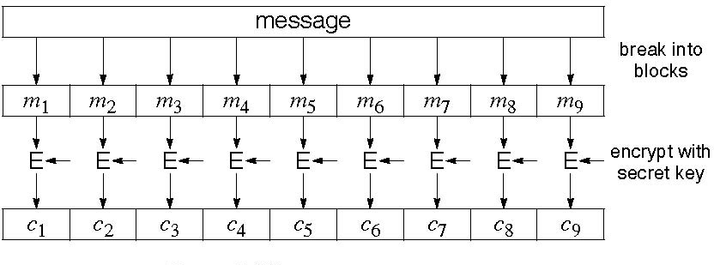
Electronic Code Book (ECB)
Each block is independently encoded
Problem:
  Identical Input➔ Identical Output
    Deterministic: the same data block gets encrypted the same way, reveals patterns of data when a data block repeats.

Slide 19
ECB critics
Weakness: Replay/Manipulation attack
  Can insert encoded blocks
  Reordering ciphertext results in reordered plaintext.
Strength:
  Errors in one ciphertext block do not propagate.
Usage:
  not recommended to encrypt more than one block of data
  Encryption in database

Slide 20
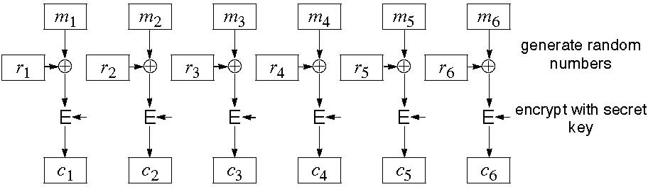
Cipher Block Chaining (CBC)
Improving on ECB: think of adding a random number before encoding

Slide 21
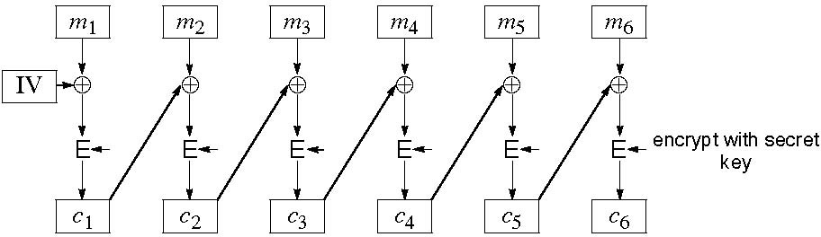
CBC (cont.)
The main idea:
  Use C_{i} as random number block operation for i+1
  So, need a so called Initial Value (IV)
    If no IV, then one can guess changed blocks

Slide 22
CBC critics
Good
  Randomized encryption: repeated text gets mapped to different encrypted data.
    Can be proven to be “secure” assuming that the block cipher has desirable properties and that random IV’s are used
  A ciphertext block depends on all preceding plaintext blocks
    reorder affects decryption
Bad
  Errors in one block propagate to two blocks
    one bit error in C_{j} affects all bits in M_{j} and one bit in M_{j}+1
  Sequential encryption, cannot use parallel hardware
  Observation: if C_{i}=C_{j} then Ek (Mi⊕Ci-1) = Ek (Mj⊕Cj-1); thus Mi⊕Ci-1 = Mj⊕Cj-1; thus Mi⊕ Mj = Ci-1 ⊕Cj-1

Slide 23
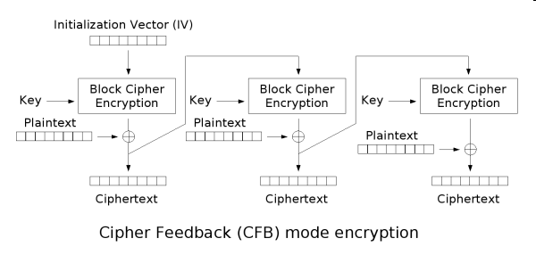
Cipher Feedback (CFB)
The message is XORed with the feedback of encrypting the previous block

Slide 24
CFB critics
Good
  Randomized encryption
  A ciphertext block depends on all preceding plaintext blocks; reorder affects decryption
Bad
  Errors propagate for several blocks after the error, but the mode is self-synchronizing (like CBC).
  Decreased throughput.
    Can vary the number of bits feed back, trading off throughput for ease of use
  Sequential encryption

Slide 25
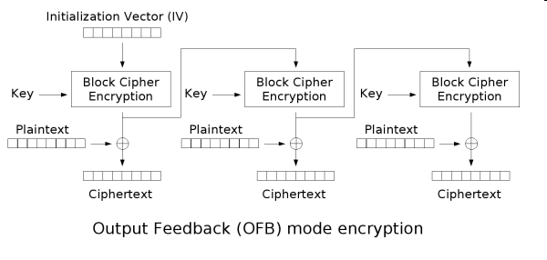
Output Feedback (OFB)
IV is used to generate a stream of blocks
Stream is used a one-time pad and XOR'ed to plain text

Slide 26
OFB critics
Randomized encryption
Sequential encryption, but preprocessing possible
Error propagation limited
Subject to limitation of stream cipher

Slide 27
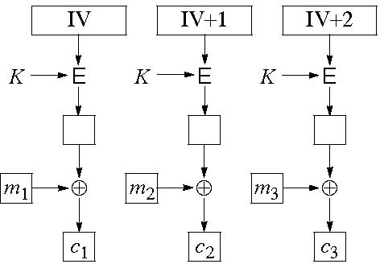
Counter Mode (CTR)
If the same IV and key is used again,
  XOR of two encrypted messages = XOR of plain text
IV is incremented and used to generated one-time pad

Slide 28
CTR critics
Software and hardware efficiency: different blocks can be encrypted in parallel.
Preprocessing: the encryption part can be done offline and when the message is known, just do the XOR.
Random access: decryption of a block can be done in random order, very useful for hard-disk encryption.
Messages of arbitrary length: ciphertext is the same length with the plaintext (i.e., no IV).

